Slide 1
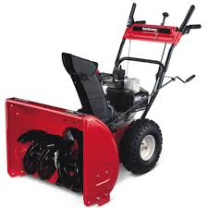
Arthur Sicard
Inventor of the Snow Blower

Slide 2
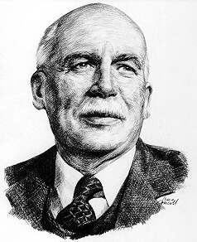
Background
Arthur Sicard was born in Saint-Léonard-de-Port-Maurice, Québec in 1876 and lived until 1946. Sicard was getting annoyed with his milk always getting spoiled because his route home was blocked by snow. He tried to fix his problem by using types of snow shovels or plows attached to the front of cars, but he wasn’t happy with these designs. He then thought of the idea for a snowblower when he saw a piece of farm equipment that was used to blow grain away. He kept his idea secret and came back to it 20 years later when he had enough money to fund it. He tested it on the Montreal streets and patented it as the “Sicard Snow Remover Snow Blower”. He also founded Sicard Industries Ltd. in the city of Sainte-Thérèse in 1927.

Slide 3
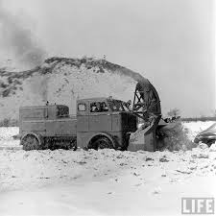
Idea
Neighbours never thought invention would work out
1925 Sicard completed his first prototype
Patented his invention
Original invention consisted of three sections
These sections included a four-wheel drive truck chassis, a truck motor, and the snow blower with two adjustable chutes
Allowed the driver to clear and throw snow over 90 feet

Slide 4
Plans and Financing
Arthur Sicard funded his own idea in 1924 with $40,000 that he had saved up for 20 years since he thought if his idea. Since he funded his own idea he didn’t need to pay anyone back and didn’t need to share his idea with people. His first model was hand built and attached to the front of a truck. He sold his first two Snow Blowers to the city of Outremont, Montreal for $13,000 each in 1927. He needed his invention to work under all conditions so he designed it so that it would operate on hard, soft, or packed snow. He also needed to make sure the truck would work through all conditions so he made sure the truck he attached it to was four-wheel drive.

Slide 5
Company Organization
Business name is Sicard SSI Group INC.
Products are sold worldwide
Knowlton, Quebec is a corporate descendant

Slide 6
What is he known for?
Snowblower

Slide 7
Future Prospects
The snowblower has evolved a lot since the first one that Arthur Sicard invented in 1925. In the mid 1950s small “walk-behind” snowblowers were produced so that everyone could get one of their own. With the introduction of more and more cars in the 1950s the snowblower became a necessity for any city to have in the winter time. All of these were very useful but also very dangerous. Over 5000 snowblower related accidents happen in the United States alone every year. Snowblowers didn’t only get smaller. There are models most commonly used in airports and military bases that clear over 12,000 tons of snow every hour.

Slide 8
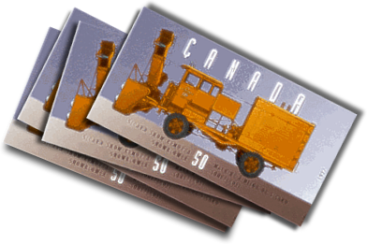
Other Interesting Facts
In 1995 the Canadian Post Office made a stamp commemorating Arthur Sicard’s first model of the snowblower.

